Slide 1
Unit 2 Part-1 Relational query languages -

Slide 2
Topics
Relational algebra,
Tuple and domain Relational calculus,
SQL3,
DDL and DML constructs,
Open source and Commercial DBMS -MYSQL, ORACLE, DB2, SQL server

Slide 3
Introduction
A query language is a language in which a user requests information from the database
Query languages can be categorized as either procedural or nonprocedural.
In a procedural language, the user instructs the system to perform a sequence of operations on the database to compute the desired result.
In a nonprocedural language, the user describes the desired information without giving a specific procedure for obtaining that information.

Slide 4
Introduction
The relational algebra is procedural, whereas the tuple relational calculus and domain relational calculus are nonprocedural.
The relational algebra consists of a set of operations that take one or two relations as input and produce a new relation as their result.
The relational calculus uses predicate logic to define the result desired without giving any specific algebraic procedure for obtaining that result.

Slide 5
Introduction
All procedural relational query languages provide a set of operations that can be applied to either a single relation or a pair of relations.
These operations have the nice and desired property that their result is always a single relation.
This property allows one to combine several of these operations in a modular way.
Specifically, since the result of a relational query is itself a relation, relational operations can be applied to the results of queries as well as to the given set of relations.

Slide 6
Relational algebra
The relational algebra is a procedural query language, serves as the basis for the SQL language.
It consists of a set of operations that take one or two relations as input and produce a new relation as their result.
The fundamental operations in the relational algebra are select, project, union, set difference, Cartesian product, and rename.
In addition to the fundamental operations, there are several other operations—namely, set intersection, natural join, and assignment

Slide 7
Relational algebra : Operations
Select
Project
Rename
Set Operators
Union
Intersect (Intersection)
Minus (Set Difference)
Cartesian-Product
Join operations
unary operations
binary operations

Slide 8
The Select Operation
Operation: Selects tuples from a relation that satisfy a given condition.
It is used to select particular tuples from a relation.
It selects particular tuples but all attribute from a relation.
Symbol: σ (Sigma)
Notation: σ_{<condition>} (Relation)
Operators: The following operators can be used in a condition.
=, !=, <, >, <=,>=, Λ(AND), ∨(OR)

Slide 9
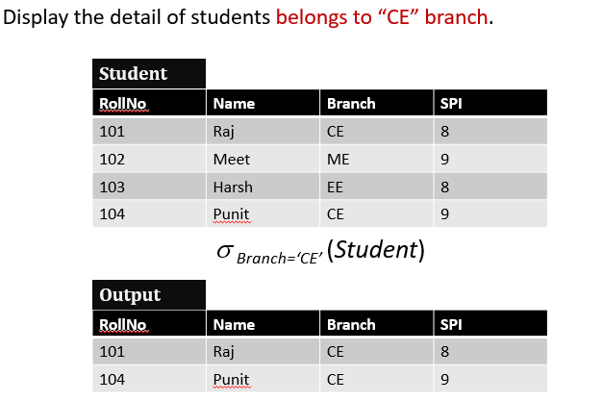

Slide 10
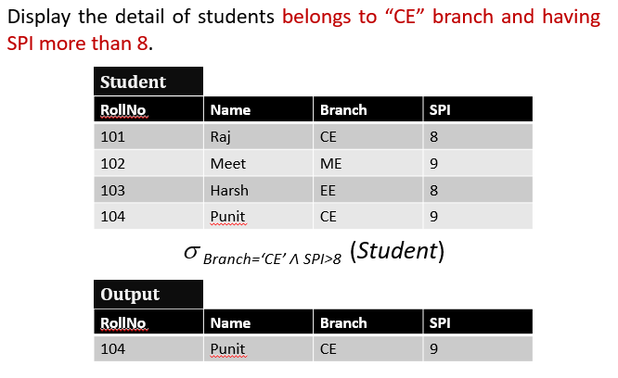

Slide 11
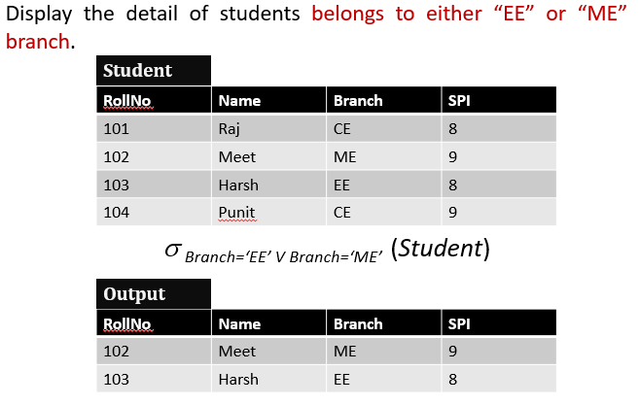

Slide 12
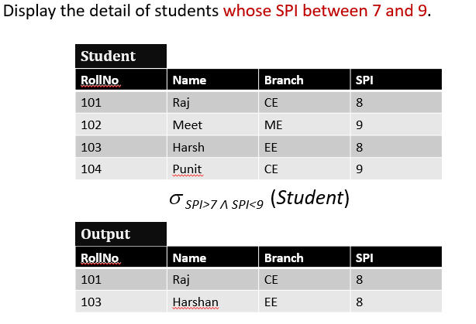

Slide 13
The Project Operation
Operation: Selects specified attributes of a relation.
It selects particular attributes but all unique tuples from a relation.
Symbol: Π (Pi)
Notation: Π (attribute set) <Relation>

Slide 14
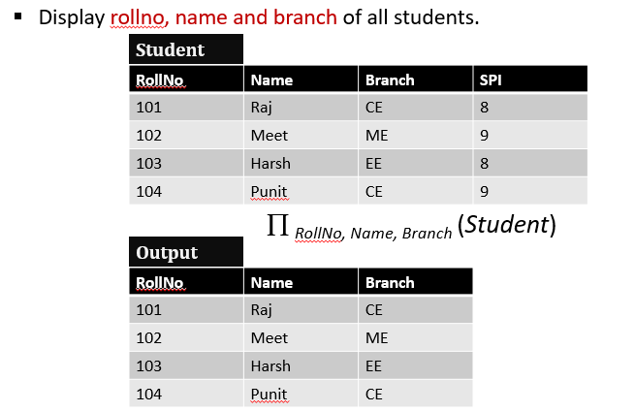

Slide 15
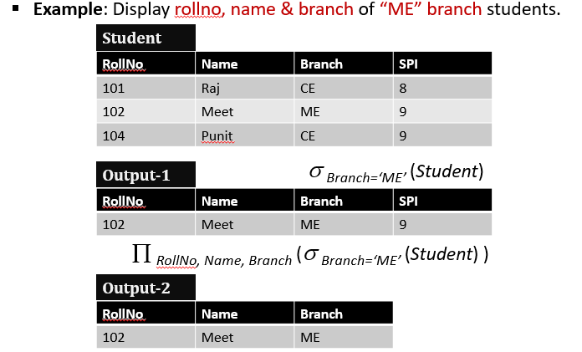

Slide 16
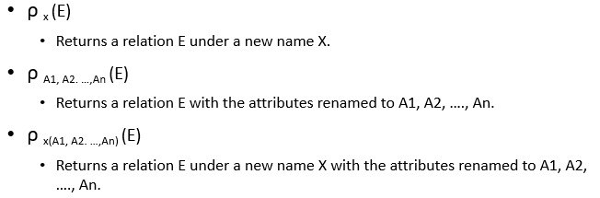
Rename
Operation: It is used to rename a relation or attributes.
Symbol: ρ (Rho)
Notation:

Slide 17
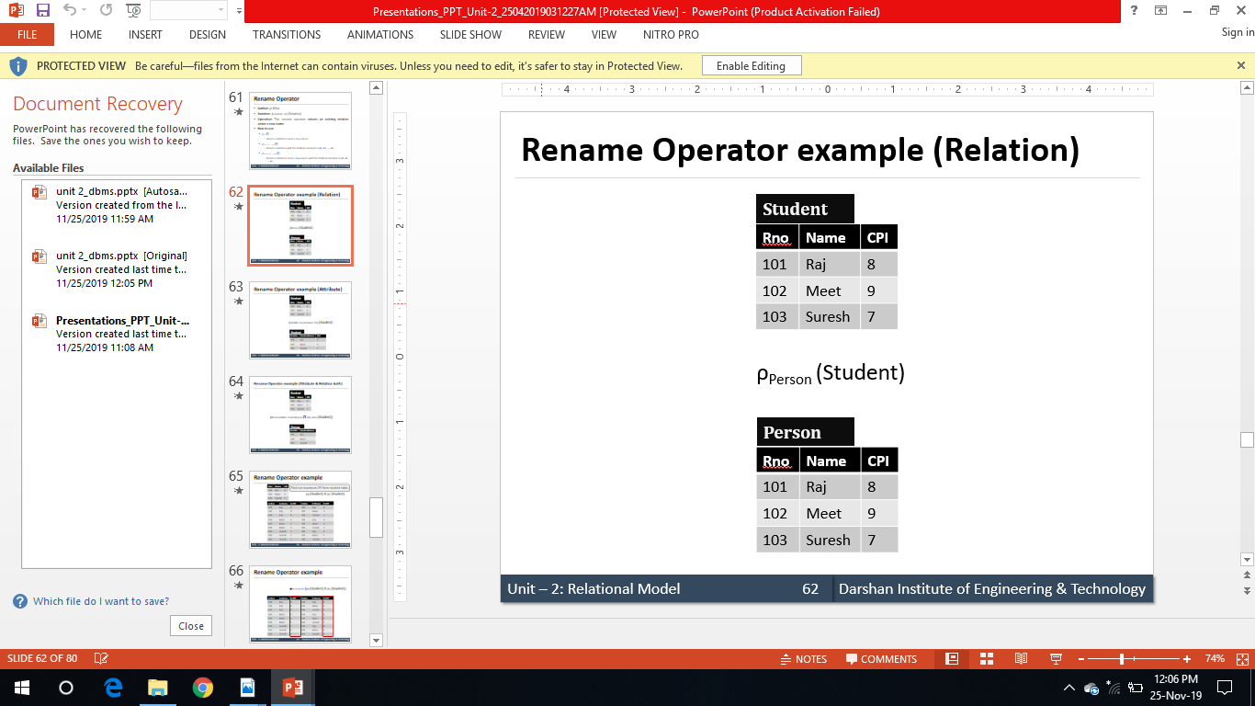
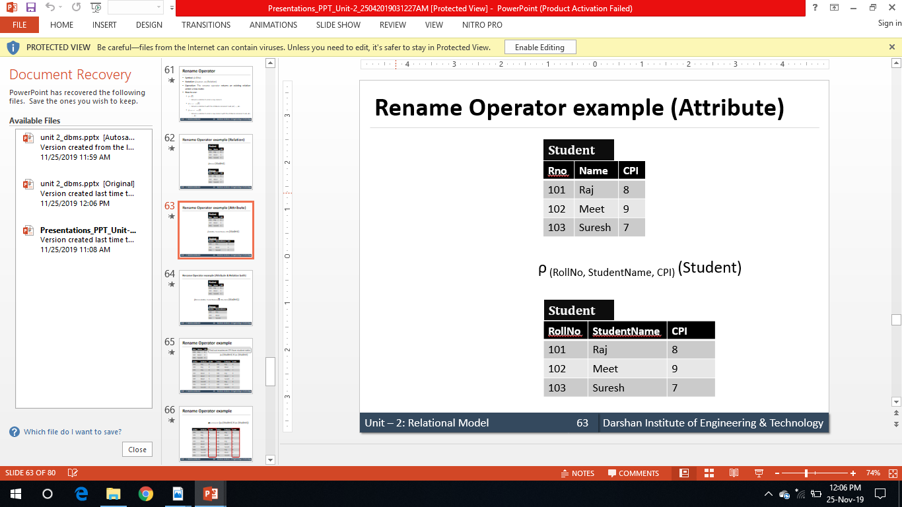
Example

Slide 18
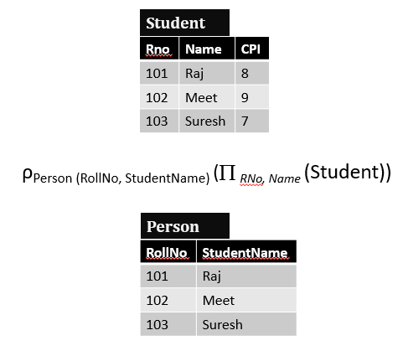
Example

Slide 19
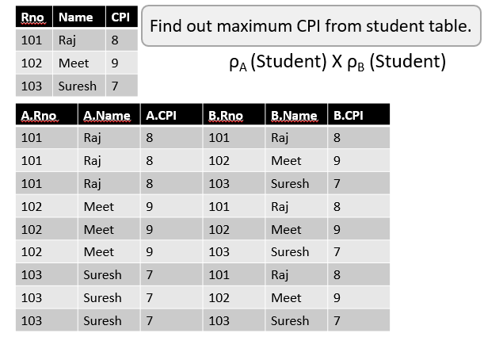
Example

Slide 20
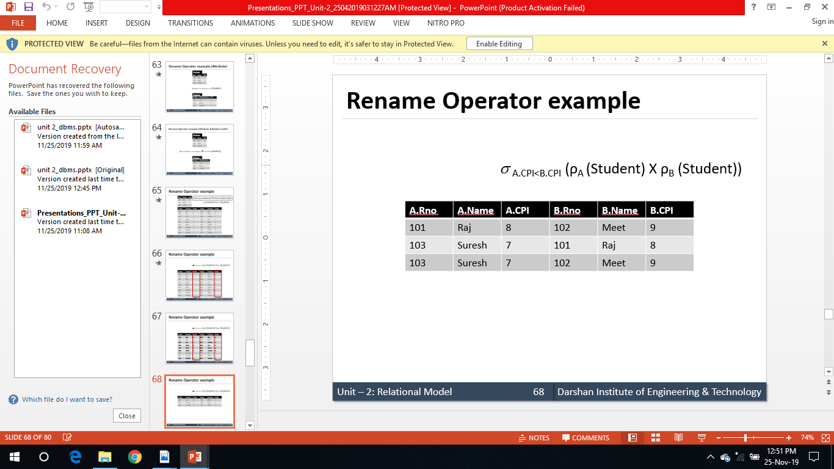
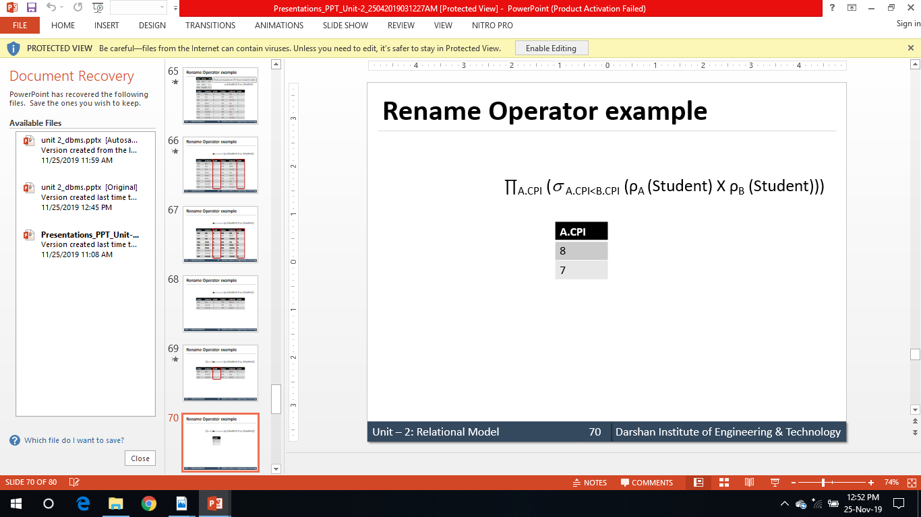
Cont..

Slide 21
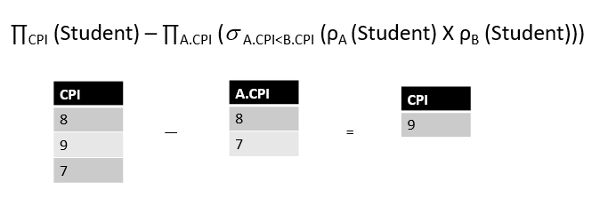
Cont..

Slide 22
Set Operators
Set operators combine the results of two or more queries into a single result.
Condition to perform set operation:
Both relations (queries) must be union compatible :
Relations R and S are union compatible, if
Both queries should have same (equal) number of columns, and
Corresponding attributes should have the same data type.
Types of set operators:
1. Union
2. Intersect (Intersection)
3. Minus (Set Difference)

Slide 23
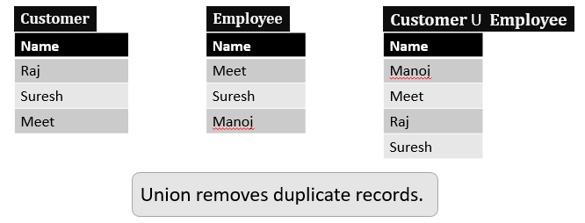
Union operator
Operation: Selects tuples those are in either or both of the relations.
Symbol : U (Union)
Notation : Relation1 U Relation2

Slide 24
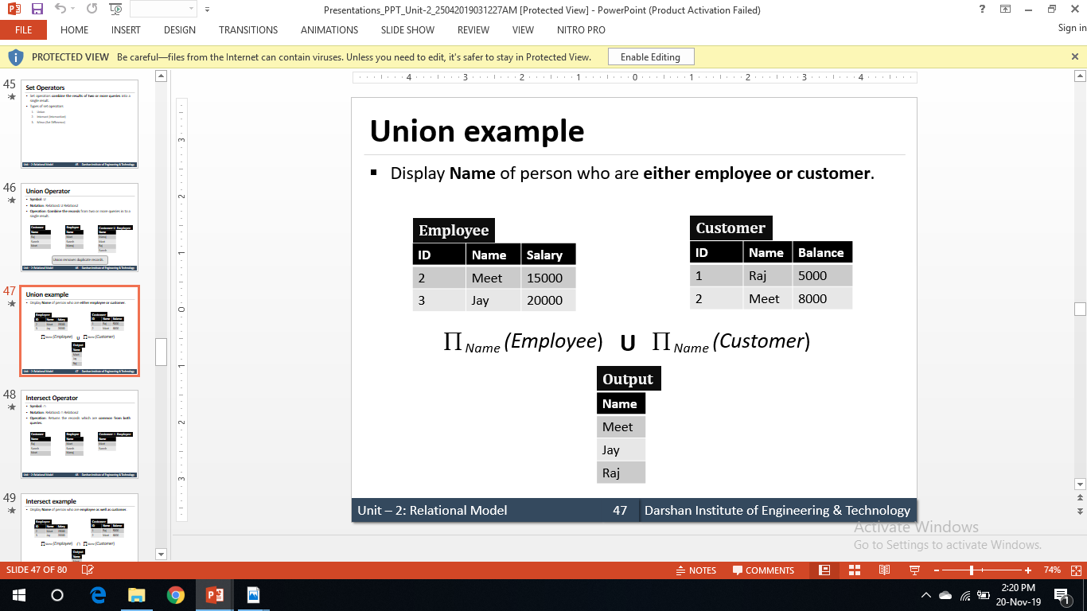
Union example

Slide 25
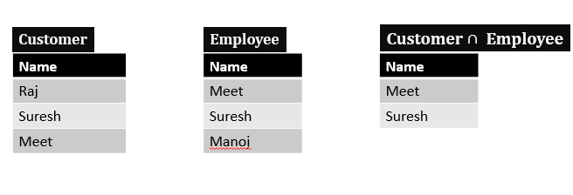
Intersection operator
Operation: Selects tuples those are common in both relations.
Symbol : ∩ (Intersection)
Notation : Relation1 ∩ Relation2

Slide 26
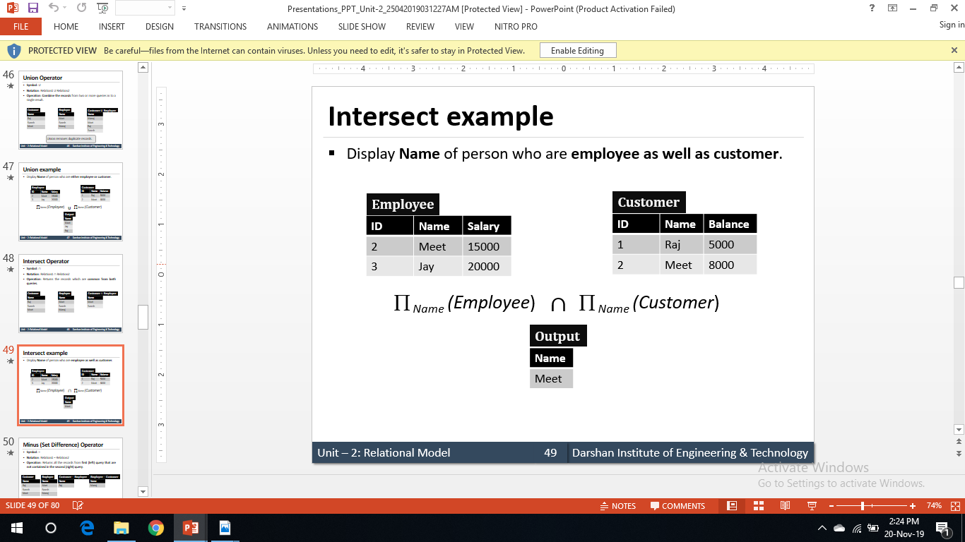
Intersect Example

Slide 27
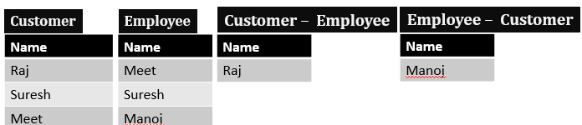
The Set-Difference (Minus ) Operation
Operation: Selects tuples those are in first (left) relation but not in second (right) relation.
Symbol : — (Minus)
Notation : Relation1 — Relation2

Slide 28
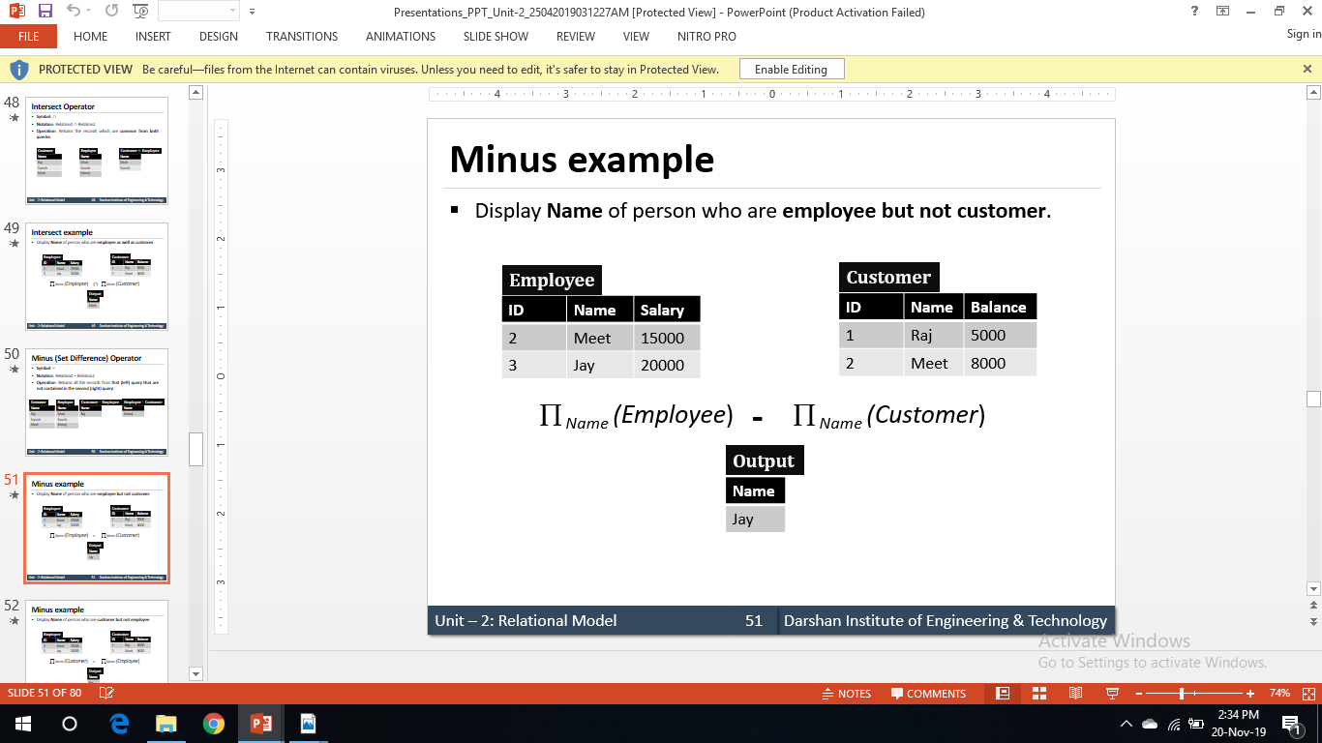
The Set-Difference (Minus ) Operation Example

Slide 29
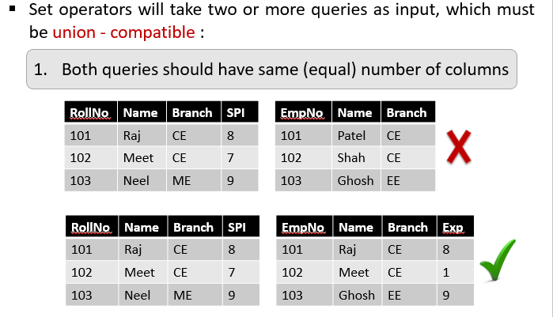
Condition to perform Set operators

Slide 30
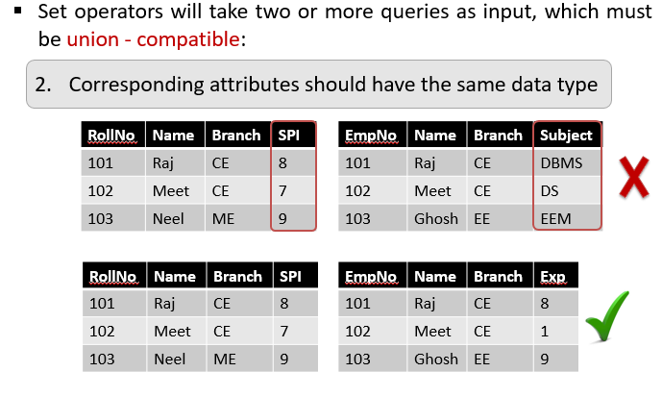
Condition to perform Set operators

Slide 31
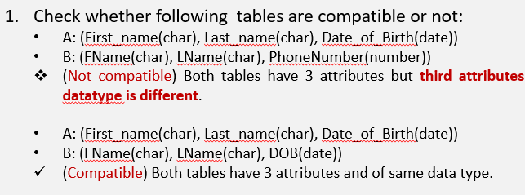
Exercise

Slide 32
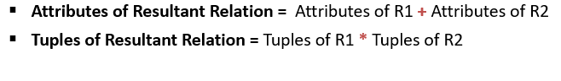
The Cartesian-Product (Cross product) Operation
Operation: Combines information of two relations. It will multiply each tuples of first relation to each tuples of second relation.
Symbol: X (Cross)
Notation: Relation1 X Relation2
Resultant Relation :
If both relations have some attribute having same name, it can be distinguished by combing relation- name. attribute-name.

Slide 33
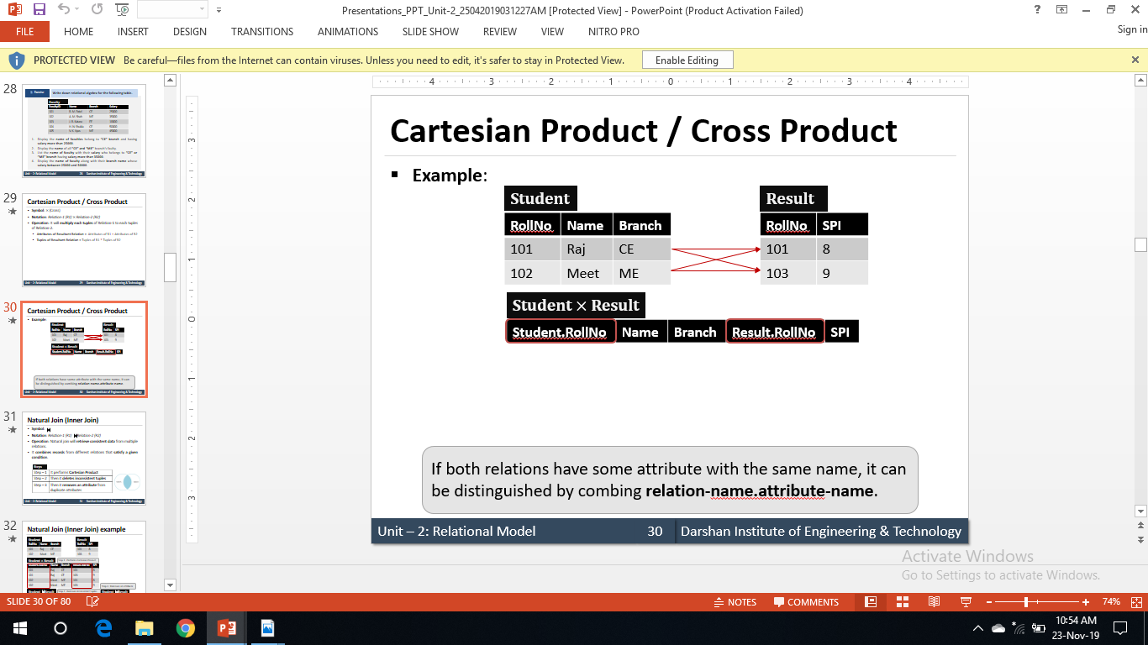
Example:

Slide 34
Join operations : Natural Join Operation (⋈)
Operation: Natural join will retrieve information from multiple relations. It works in three steps.
1. It performs Cartesian product
2. Then it finds consistent tuples and inconsistent tuples are deleted
3. Then it deletes duplicate attributes
Notation: Relation1 ⋈ Relation2
To perform a natural join there must be one common attribute (column) between two relations.

Slide 35
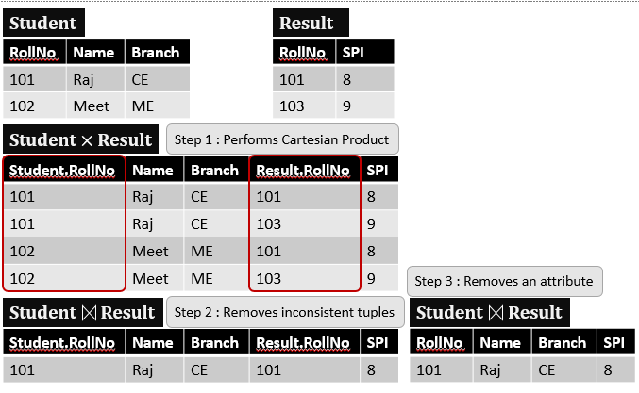
Example

Slide 36
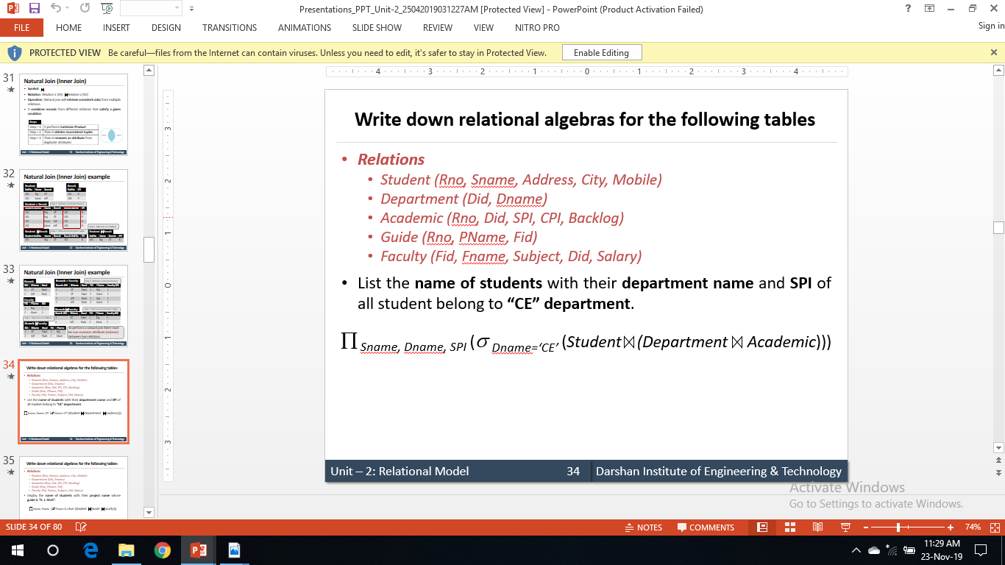
Example

Slide 37
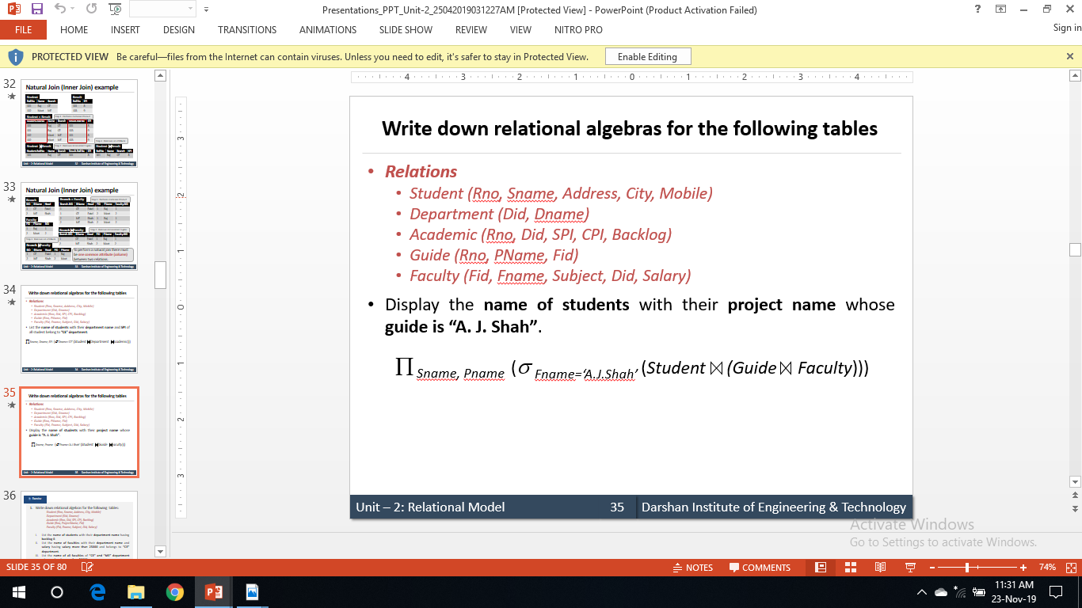
Example

Slide 38
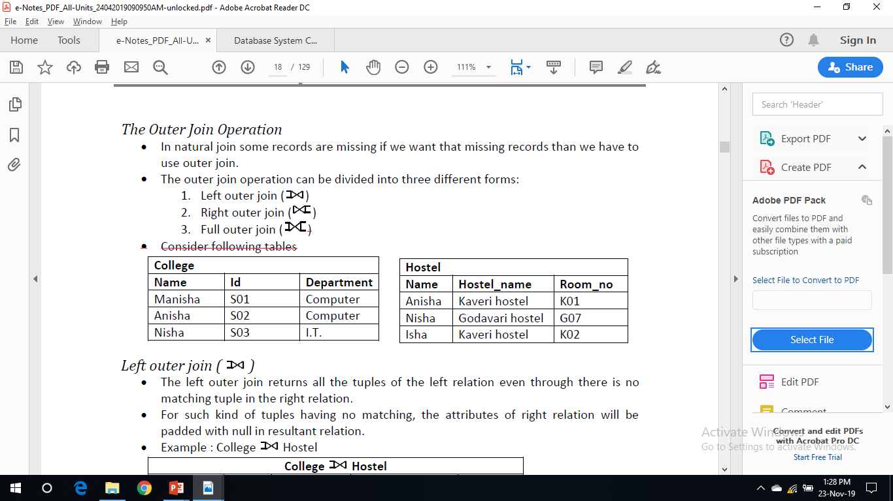
The Outer Join Operation
In natural join some records are missing if we want that missing records than we have to use outer join.
The outer join operation can be divided into three different forms:
1. Left outer join ( )
2. Right outer join ( )
3. Full outer join ( )

Slide 39
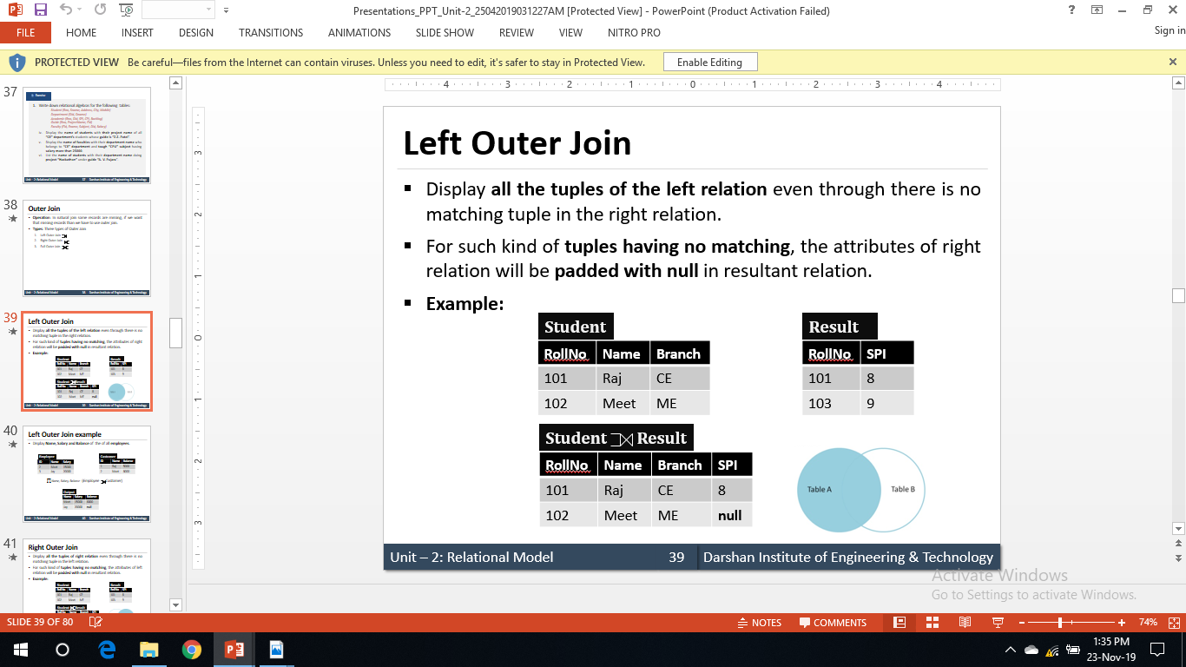
Left outer join ( )
The left outer join returns all the tuples of the left relation even through there is no matching tuple in the right relation.
For such kind of tuples having no matching, the attributes of right relation will be padded with null in resultant relation.

Slide 40
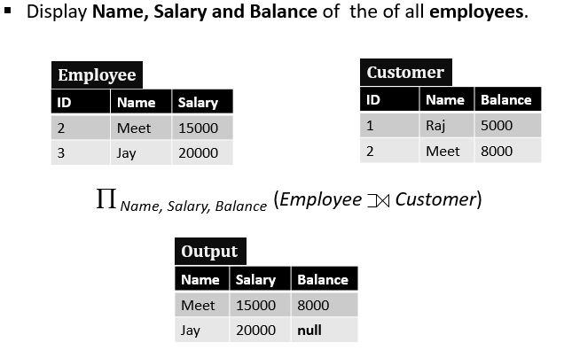
Example

Slide 41
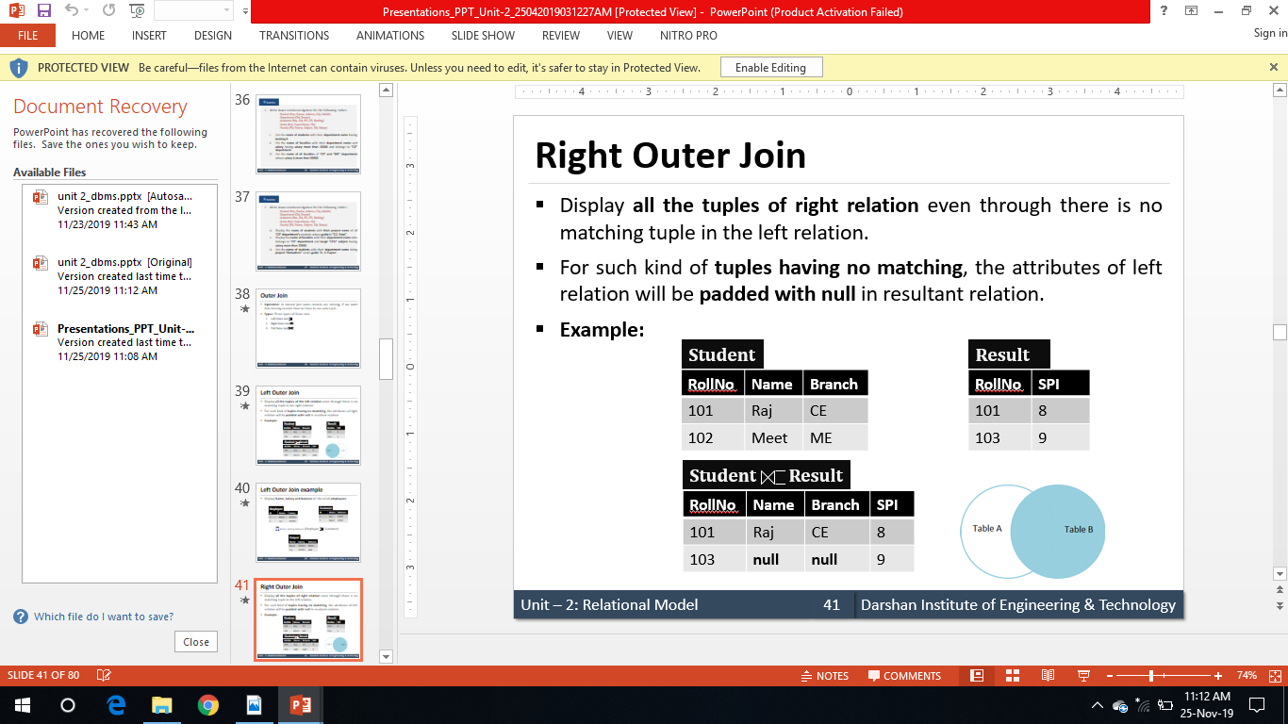
Right outer join ( )
The right outer join returns all the tuples of the right relation even though there is no matching tuple in the left relation.
For such kind of tuples having no matching, the attributes of left relation will be padded with null in resultant relation.

Slide 42
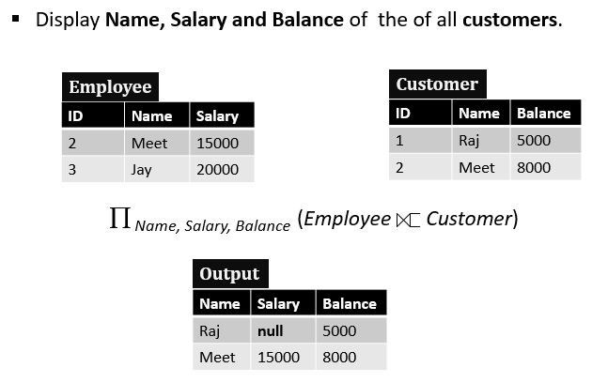
Example

Slide 43
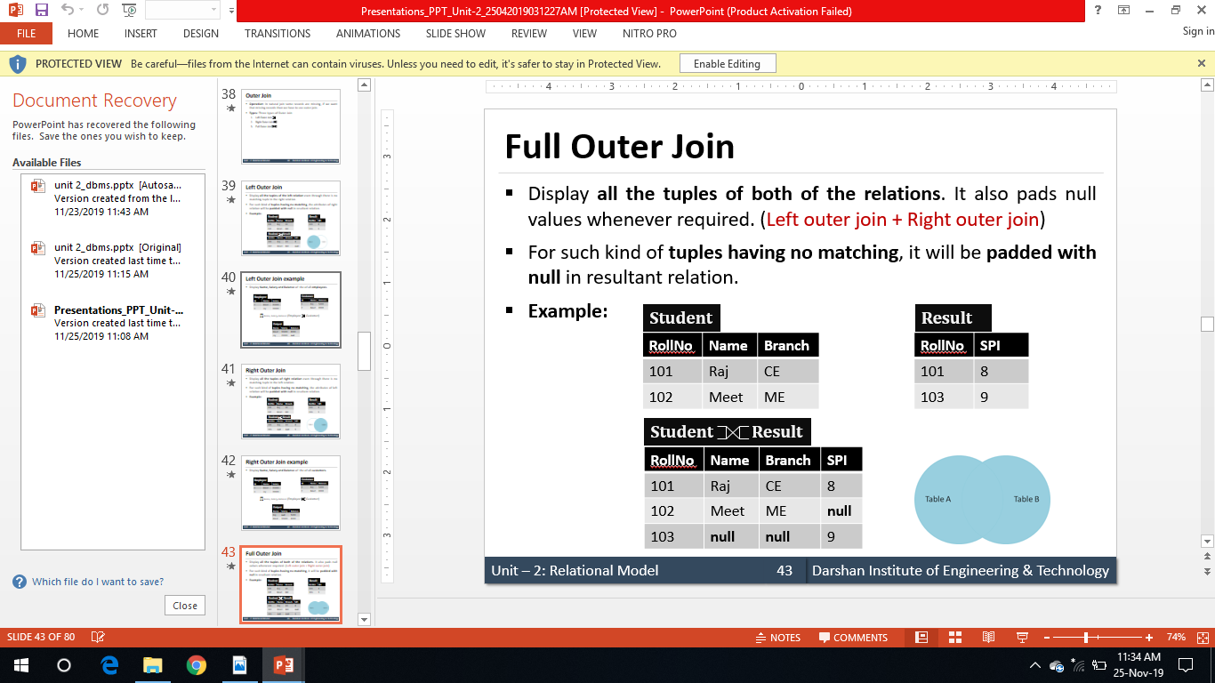

Full outer join ( )
The full outer join returns all the tuples of both of the relations. It also pads null values whenever required.

Slide 44
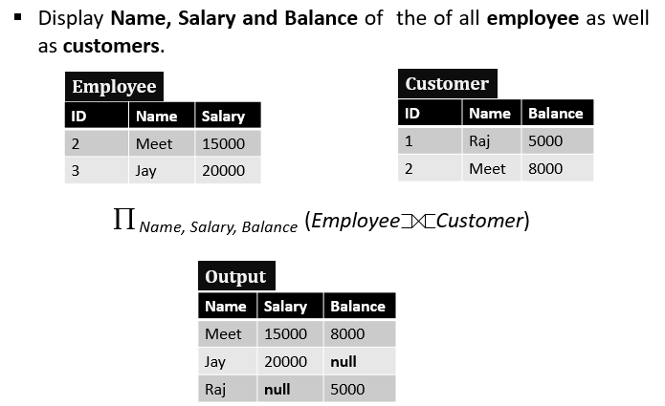
Example

Slide 45
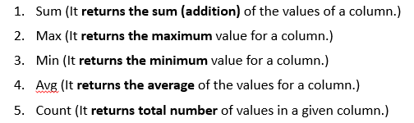
Aggregate Function
Operation: It takes a more than one value as input and returns a single value as output (result).
Symbol: G
Notation: G _{function (attribute)} (relation)
Aggregate functions:

Slide 46
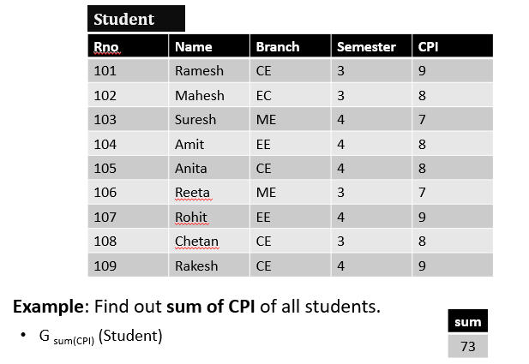
Aggregate Function Example

Slide 47
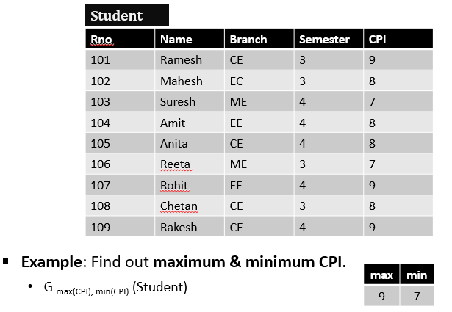
Aggregate Function Example

Slide 48

Aggregate Function Example

Slide 49
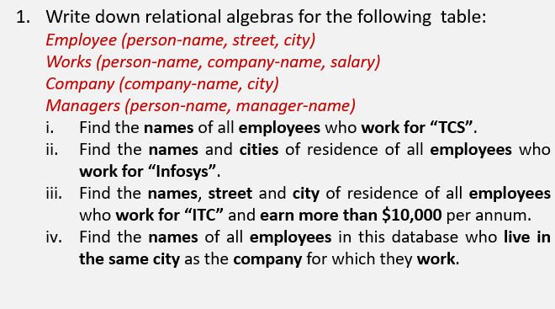
Exercise

Slide 50
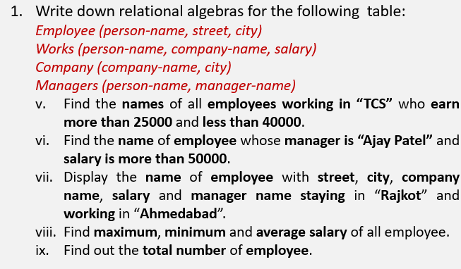
Exercise

Slide 51
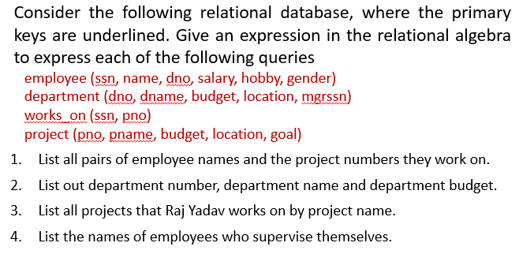
Exercise

Slide 52
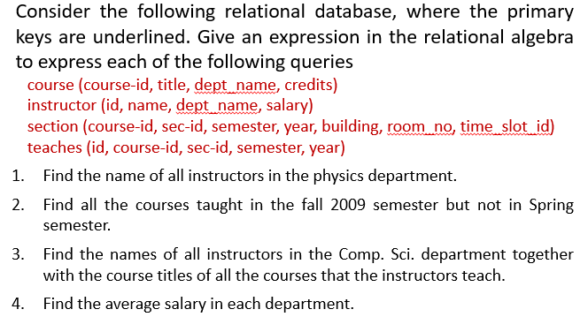
Exercise

Slide 53
Tuple Relational calculus
The tuple relational calculus is a nonprocedural query language. It describes the desired information without giving a specific procedure for obtaining that information.
A query in the tuple relational calculus is expressed as:
{t | P(t)}
“set of all tuples t such that predicate P is true for t”
∃ t ∈ r (Q(t))
“there exists a tuple t in relation r such that predicate Q(t) is true”

Slide 54
Student(rollno,name,dept,gender)
1) find out all details of students
Sql:select * from student
TRC:{t / student(t)}
2)Display all details of students whose dept no is 120
TRC: {t/ student(t)
3) Find details of male students whose dept no is 100
4)Find roll numbers of all the students.

Slide 55
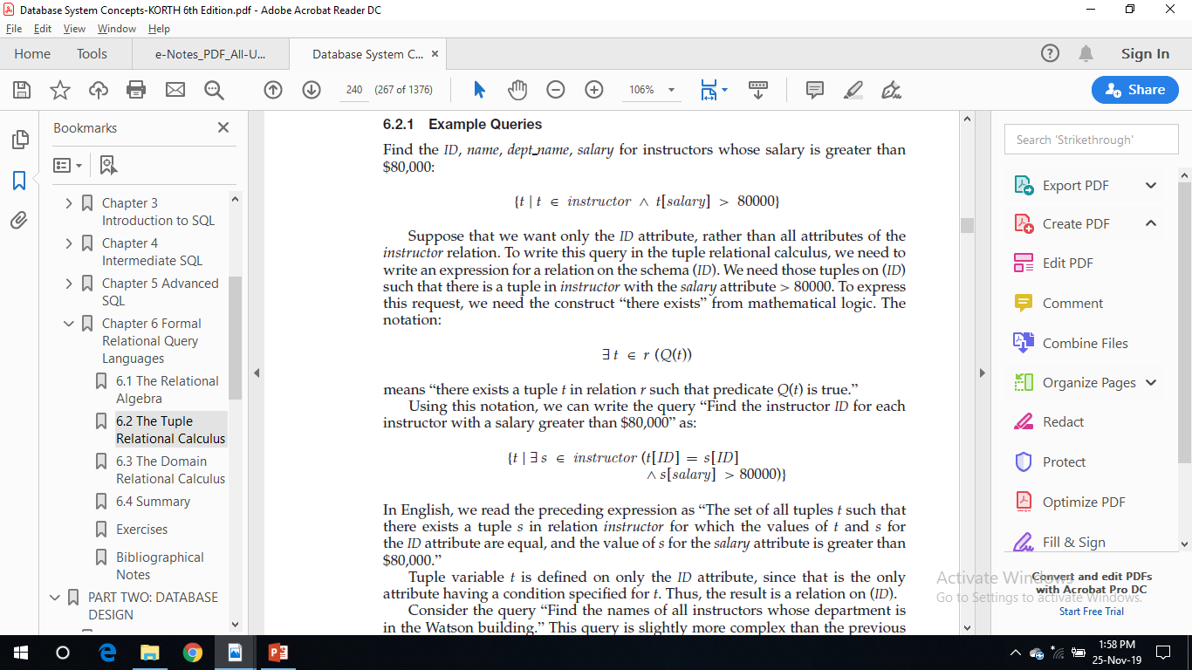
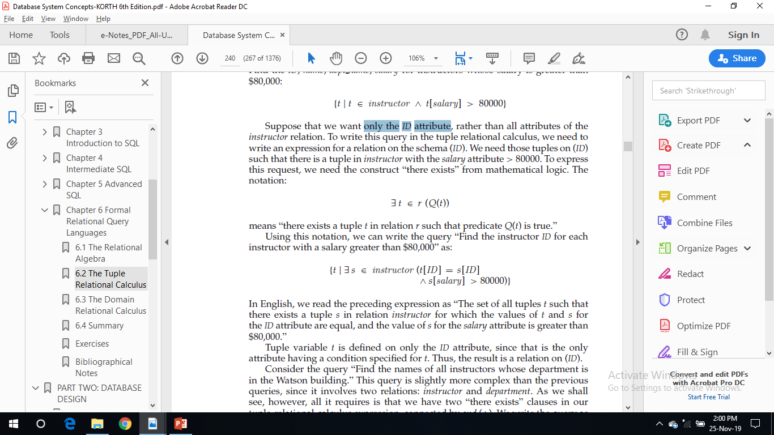
Example Queries
Find the ID, name, dept name, salary for instructors whose salary is greater than $80,000:
Find the instructor ID for each instructor with a salary greater than $80,000
“The set of all tuples t such that there exists a tuple s in relation instructor for which the values of t and s for the ID attribute are equal, and the value of s for the salary attribute is greater than $80,000.”

Slide 56
Domain Relational calculus
It uses domain variables that take on values from an attributes domain, rather than values for an entire tuple.
An expression in the domain relational calculus is of the form
{< x1, x2, . . . , xn > | P(x1, x2, . . . , xn)}
where x1, x2, . . . , xn represent domain variables.

Slide 57
Example Queries
Find the instructor ID, name, dept name, andsalary for instructors whose salary is greater than $80,000:
{< i, n, d, s > | < i, n, d, s > ∈ instructor ∧ s > 80000}

Slide 58
Expressive Power of Languages
All three of the following are equivalent:
• The basic relational algebra (without the extended relational-algebra operations such as generalized projection and aggregation (G))
• The tuple relational calculus restricted to safe expressions
• The domain relational calculus restricted to safe expressions

Slide 59
SQL

Slide 60
The SQL language has several parts:
• Data-definition language (DDL). The SQL DDL provides commands for defining relation schemas, deleting relations, and modifying relation schemas.
• Data-manipulation language (DML). The SQL DML provides the ability to query information from the database and to insert tuples into, delete tuples from, and modify tuples in the database.

Slide 61
Integrity. The SQL DDL includes commands for specifying integrity constraints that the data stored in the database must satisfy. Updates that violate integrity constraints are disallowed.
• View definition. The SQL DDL includes commands for defining views.
• Authorization: The SQL DDL includes commands for specifying access rights to relations and views.

Slide 62
• Embedded SQL and dynamic SQL: define how SQL statements can be embedded within general-purpose programming languages, such as C, C++, and Java.
• Transaction control. SQL includes commands for specifying the beginning and ending of transactions.

Slide 63
sql
These SQL commands are mainly categorized into four categories as:
DDL – Data Definition Language
DQl – Data Query Language
DML – Data Manipulation Language
DCL – Data Control Language

Slide 64
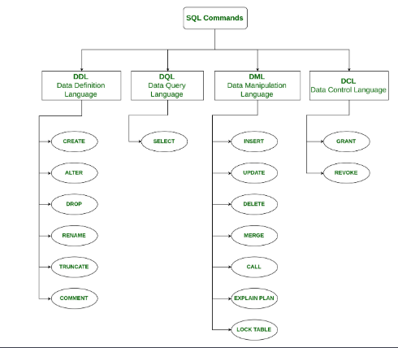

Slide 65
DDL constructs
The SQL DDL allows specification of a set of relations and information about each relation, including:
• The schema for each relation.
• The types of values associated with each attribute.
• The integrity constraints.
• The set of indices to be maintained for each relation.
The security and authorization information for each relation.
• The physical storage structure of each relation on disk.

Slide 66
Cont..
It provides commands like:
CREATE: to create objects in a database.
ALTER: to alter the schema, or logical structure of the database.
DROP: to delete objects from the database.
TRUNCATE: to remove all records from the table.

Slide 67
Create Table
The CREATE TABLE statement is used to create a new table in a database.
Syntax:
CREATE TABLE table_name(
Column1 Datatype(Size) [ NULL | NOT NULL ],
Column2 Datatype(Size) [ NULL | NOT NULL ], ... );
Example:
CREATE TABLE Students(
Roll_No int(3) NOT NULL,
Name varchar(20),
Subject varchar(20) );
Notes:
The column should either be defined as NULL or NOT NULL. By default, a column can
hold NULL values. The NOT NULL constraint enforces a column to NOT accept NULL values. This enforces a
field to always contain a value, which means that you cannot insert a new record, or
update a record without adding a value to this field.

Slide 68
Basic Types
The SQL standard supports a variety of built-in types, including:
char(n): A fixed-length character string with user-specified length n. The full form, character, can be used instead.
• varchar(n): A variable-length character string with user-specified maximum
length n. The full form, character varying, is equivalent.
• int: An integer (a finite subset of the integers that is machine dependent). The
full form, integer, is equivalent.
• smallint: A small integer (a machine-dependent subset of the integer type).

Slide 69
Basic Types
• numeric(p, d):Afixed-point numberwith user-specified precision. The number
consists of p digits (plus a sign), and d of the p digits are to the right of
the decimal point. Thus, numeric(3,1) allows 44.5 to be stored exactly, but
neither 444.5 or 0.32 can be stored exactly in a field of this type.
• real, double precision: Floating-point and double-precision floating-point
numbers with machine-dependent precision.
• float(n): A floating-point number, with precision of at least n digits.
Each type may include a special value called the null value. A null value indicates an absent value that may exist but be unknown or that may not exist at all.

Slide 70
Basic Types
The char data type stores fixed length strings. Consider, for example, an attribute A of type char(10). If we store a string “Avi” in this attribute, 7 spaces are appended to the string to make it 10 characters long. In contrast, if attribute B were of type varchar(10), and we store “Avi” in attribute B, no spaces would be added.
When comparing a char type with a varchar type, even if the same value “Avi” is stored in the attributes A and B above, a comparison A=B may return false. We recommend you always use the varchar type instead of the char type to avoid these problems.

Slide 71
ALTER
ALTER TABLE statement is used to add, modify, or drop columns in a table.
Add Column: The ALTER TABLE statement in SQL to add new columns in a table.
Syntax:
ALTER TABLE table_name ADD Column1 Datatype(Size), Column2 Datatype(Size), … ;
Example:
ALTER TABLE Students ADD Marks int;

Slide 72
ALTER
Drop Column: The ALTER TABLE statement in SQL to drop a column in a table.
Syntax:
ALTER TABLE table_name DROP COLUMN column_name;
Example:
ALTER TABLE Students DROP COLUMN Subject;
Modify Column : The ALTER TABLE statement in SQL to change the data type/size of a column in a table.
Syntax:
ALTER TABLE table_name ALTER COLUMN column_name datatype(size);
Example:
ALTER TABLE Students ALTER COLUMN Roll_No float;

Slide 73
DROP
Drop is used to drop the database or its objects like table, view, index etc.
Drop Table: The DROP TABLE statement is used to drop an existing table in a database.
Syntax:
DROP TABLE table_name;
Example:
DROP TABLE Students;

Slide 74
TRUNCATE
Truncate is used to remove all records from the table.
Syntax:
TRUNCATE TABLE table_name;
Example:
TRUNCATE TABLE Students;

Slide 75
DML constructs
It is a set of SQL commands used to insert, modify and delete data in a database.
It is normally used by general users who are accessing database via pre-developed
applications.
It provides commands like:
INSERT: to insert data into a table.
UPDATE: to modify existing data in a table.
DELETE: to delete records from a table.

Slide 76
DQL constructs
DQL (Data Query Language)
It is a component of SQL that allows data retrieval from the database.
It provides command like SELECT. This command is a heart of SQL, and allows data retrieval in different ways.
SELECT: The SELECT statement is used to select data from a database. The data returned is stored in a result table, called the result-set.
Syntax:
SELECT column1, column2, ...
FROM table_name
WHERE condition;

Slide 77
DCL
DCL (Data Control Language)
It is set of SQL commands used to control access to data and database. Occasionally DCL
commands are grouped with DML commands.
It provides commands like:
GRANT: to give access privileges to users on the database.
REVOKE: to withdraw access privileges given to users on the database.

Slide 78
TCL
TCL (Transaction Control Language)
TCL is abbreviation of Transactional Control Language. It is used to manage different transactions occurring within a database.
COMMIT – Saves work done in transactions
ROLLBACK – Restores database to original state since the last COMMIT command in transactions
SAVE TRANSACTION – Sets a save point within a transaction.

Slide 79
Integrity constraints
SQL supports a number of different integrity constraints. For example
primary key (Aj1 , Aj2, . . . , Ajm ): The primary-key specification says that attributes Aj1 , Aj2, . . . , Ajm form the primary key for the relation. The primarykey attributes are required to be nonnull and unique
foreign key (Ak1 , Ak2, . . . , Akn ) references s: Theforeign key specification says that the values of attributes (Ak1 , Ak2, . . . , Akn ) for any tuple in the relation must correspond to values of the primary key attributes of some tuple in relation s.

Slide 80
Open source and Commercial DBMS -MYSQL, ORACLE, DB2, SQL server

Slide 81
Unit 2 Part-II Relational database design -
Prof Vaibhavi Patel

Slide 82
Topics
Domain and data dependency
Armstrong's axioms
Lossless design
Normal forms

Slide 83
Domain and data dependency
Dependencies in DBMS is a relation between two or more attributes. It has the following types in DBMS:
Functional Dependency
Fully-Functional Dependency
Transitive Dependency
Multivalued Dependency
Partial Dependency

Slide 84
Functional Dependency
Let R be a relation schema having n attributes A1, A2, A3,…, An.
Let attributes X and Y are two subsets of attributes of relation R.
If the values of the X component of a tuple uniquely (or functionally) determine the values of the Y component, then, there is a functional dependency from X to Y.
This is denoted by X → Y.
It is referred as: Y is functionally dependent on the X, or X functionally determines Y.
The left hand side of the FD is also referred as determinant whereas the right hand side of the FD is referred as dependent.

Slide 85
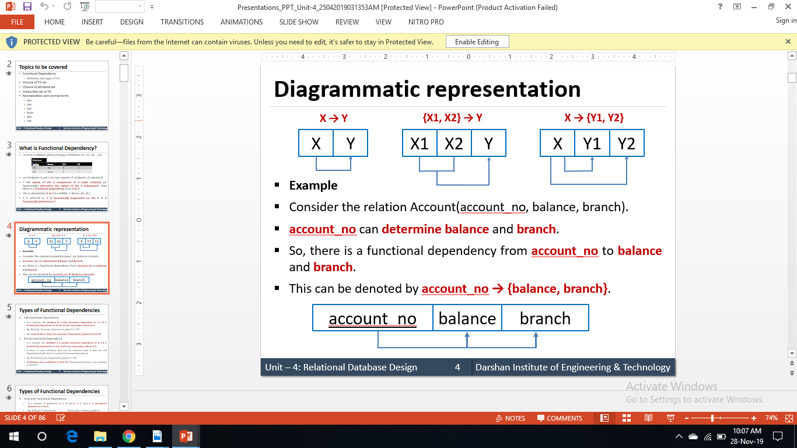
Diagrammatic representation

Slide 86
Types of Functional Dependencies
Full Dependency
In a relation, the attribute B is fully functional dependent on A if B is functionally dependent on A, but not on any proper subset of A.
Eg. {Roll_No, Department_Name, Semester} →SPI
We need all three {Roll_No, Department_Name, Semester} to find SPI

Slide 87
Types of Functional Dependencies
Partial Dependency
In a relation, the attribute B is partial functional dependent on A if B is functionally dependent on A as well as on any proper subset of A.
If there is some attribute that can be removed from A and the still dependency holds.
Eg. {Enrollment_No, Department_Name} → SPI
Enrollment_no is sufficient to find SPI, Department_name is not required.

Slide 88
Types of Functional Dependencies
Transitive Dependency
In a relation, if attribute(s) A→B and B→C, then C is transitively depends on A via B .
Eg. Staff_No → Branch_No and Branch_No → Branch_Address
Trivial FD: It is always valid fd
X→Y is trivial FD if Y is a subset of X
Eg.{Roll_No, Department_Name} → Roll_No
Nontrivial FD
X→Y is nontrivial FD if Y is not a subset of X
Eg.. {Roll_No, Department_Name} → Student_Name

Slide 89
Armstrong's axioms (inference rules)
Armstrong's axioms are a set of rules used to infer (derive) all the functional dependencies on a relational database.
Let A, B, and C is subsets of the attributes of the relation R.
Reflexivity : If B is a subset of A then A → B
Augmentation: If A → B then AC → BC
Transitivity: If A → B and B → C then A → C

Slide 90
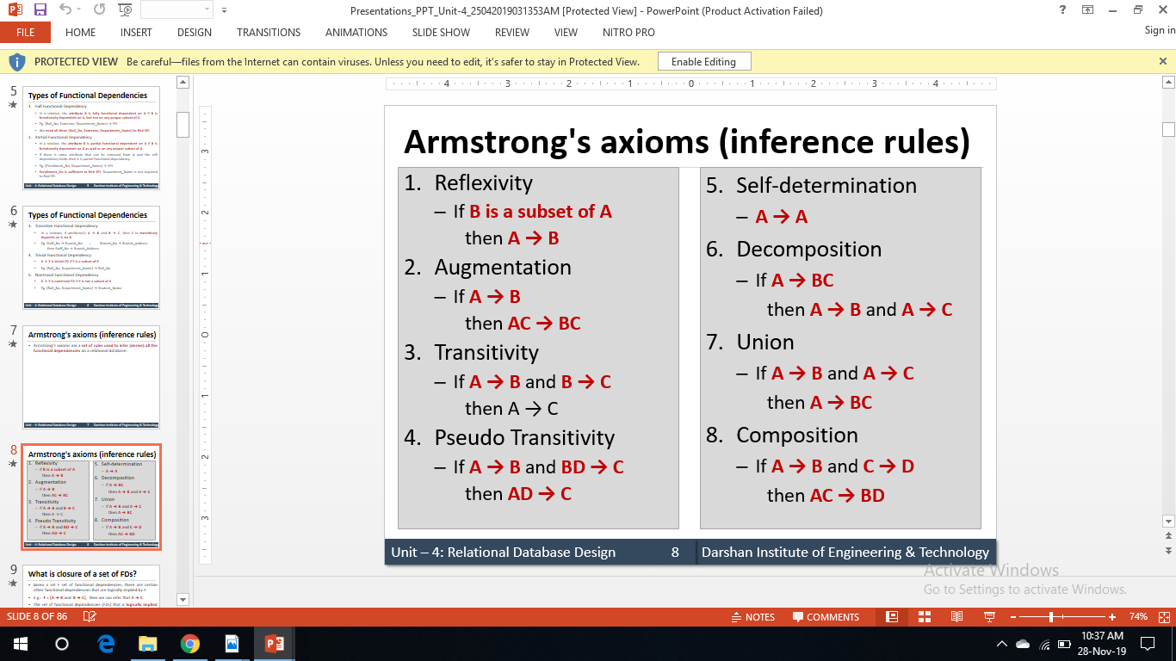
Armstrong's axioms (inference rules)

Slide 91
closure of a set of FDs
Given a set F set of functional dependencies, there are certain other functional dependencies that are logically implied by F.
E.g.: F = {A → B and B → C}, then we can infer that A → C
The set of functional dependencies (FDs) that is logically implied by F is called the closure of F.
It is denoted by F+.

Slide 92
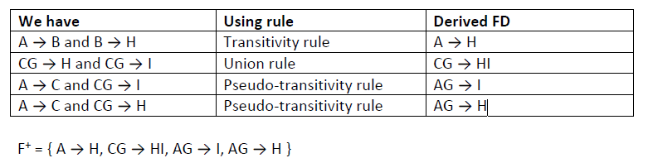
Example-1
Suppose a relation R is given with attributes A, B, C, G, H and I. Also, a set of functional dependencies F is given with following FDs.
F = {A → B, A → C, CG → H, CG → I, B → H}
Closure of F.

Slide 93
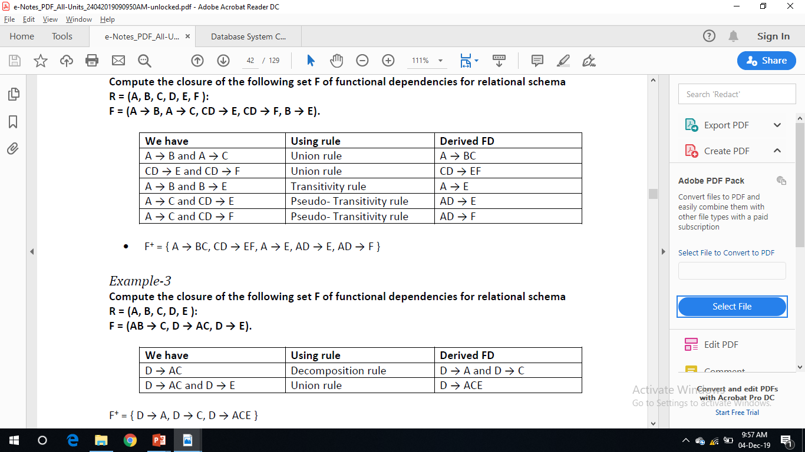
Example-2
Compute the closure of the following set F of functional dependencies for relational schema
R = (A, B, C, D, E, F ):
F = (A → B, A → C, CD → E, CD → F, B → E).

Slide 94
Example-3
Compute the closure of the following set F of functional dependencies for relational schema
R = (A, B, C, D, E ):
F = (AB → C, D → AC, D → E).

Slide 95
Closure of a set of attributes
Closure of set of attributes
Given a set of attributes α, the closure of α under F is the set of attributes that are
functionally determined by α under F.
OR IT CONTAINS SET OF ATTRIBUTES DETERMINE BY α.
It is denoted by α+.

Slide 96
Given relation R with attributes A,B, C,D,E,F and set of FDs as
A → BC, E → CF, B → E and CD → EF.
Find out closure {A, B}+ of the set of attributes
Ans: Closure of {A, B}+ is {A, B, C, E, F}.

Slide 97
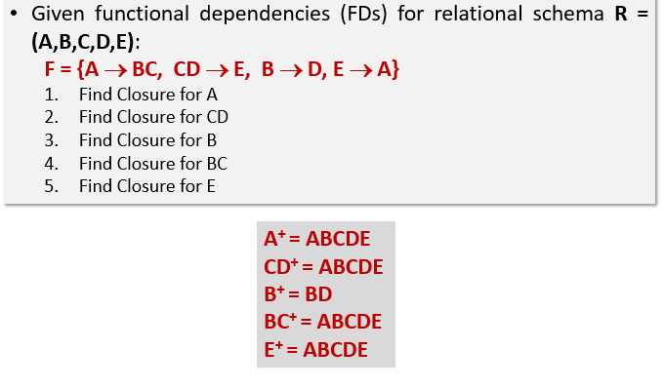
Exercise

Slide 98
Exercise
R(A,B,C,D,E)
FD { A->B, B->C, C->D,D->E}
FIND CLOSUER SET OR ATTRIBUTE CLOSURE OF
1)A 2) B 3) C 4) D 5) E 6) AB 7) ABCD 8) ACD

Slide 99

Canonical cover
A canonical cover of F is a minimal set of functional dependencies equivalent to F, having no redundant dependencies or redundant parts of dependencies.
It is denoted by Fc.
A canonical cover for F is a set of dependencies Fc such that
1) F logically implies all dependencies in Fc, and
2) Fc logically implies all dependencies in F, and
3) No functional dependency in Fc contains an extraneous attribute, and
4) Each left side of functional dependency in Fc is unique.
Notes:
If we are able to remove an attribute from a functional dependency without changing the closure of the set of functional dependencies, that attribute is called as Extraneous Attribute

Slide 100
STEPS TO FIND CANONICAL COVER FORM
1. Simplify all RHS (Decomposition)
2. For all FDs on LHS find For all FDs on LHS find a redundant redundant (extraneous extraneous ) attribute
3. Eliminate all redundant FDs
4. Apply Union if needed
5. The result is Fc
extraneous attributes :If we are able to remove an attribute from a functional dependency without changing the closure of the set of functional dependencies, that attribute is called as Extraneous Attribute

Slide 101
Example
Consider following set F of functional dependencies on schema R(A,B,C) and compute canonical cover for F.
A -> BC, B -> C, A -> B and AB -> C
Ans: canonical cover is: A → B, B → C
2)R{A,B,C}
FD={A->BC,B->C,A->B,AB->C}
3) R = {A,B,C,D,E,F,G,H}
F = {AC →G, D →EG, BC →D, CG →BD, ACD →B, CE →AG} Find
the canonical cover of F.
* Different order of considering the extraneous attributes can result in different FC
Notes:
FC = {AC→B, D→EG, BC→D, CG→D, CE→A}

Slide 102
Decomposition
Decomposition is the process of breaking down given relation into two or more relations.
Here, relation R is replaced by two or more relations in such a way that -
1. Each new relation contains a subset of the attributes of R, and
2. Together, they all include all tuples and attributes of R.
There are two types of decomposition
1. lossy decomposition
2. lossless decomposition (non-loss decomposition)

Slide 103
Lossy Decomposition
The decomposition of relation R into R1 and R2 is lossy when the join of R1 and R2 does not yield the same relation as in R.
This is also referred as lossy-join decomposition.
The disadvantage of such kind of decomposition is that some information is lost during retrieval of original relation.
From practical point of view, decomposition should not be lossy decomposition.

Slide 104

Lossy Decomposition
Here, it is not possible to specify that in which branch account A01 or A02 belongs

Slide 105
Lossless (Non-loss) Decomposition
The decomposition of relation R into R1 and R2 is lossless when the join of R1 and R2 produces the same relation as in R.
This is also referred as a non-additive (non-loss) decomposition.
All decompositions must be lossless.

Slide 106

Lossless (Non-loss) Decomposition

Slide 107
To check for lossless join decomposition using FD set, following conditions must hold:
Union of Attributes of R1 and R2 must be equal to attribute of R. Each attribute of R must be either in R1 or in R2.
Att(R1) U Att(R2) = Att(R)
Intersection of Attributes of R1 and R2 must not be NULL.
Att(R1) ∩ Att(R2) ≠ Φ
Common attribute must be a key for at least one relation (R1 or R2) Att(R1) ∩ Att(R2) -> Att(R1) or Att(R1) ∩ Att(R2) -> Att(R2)

Slide 108
For Example, A relation R (A, B, C, D) with FD set{A->BC} is decomposed into R1(ABC) and R2(AD) which is a lossless join decomposition as:
First condition holds true as Att(R1) U Att(R2) = (ABC) U (AD) = (ABCD) = Att(R).
Second condition holds true as Att(R1) ∩ Att(R2) = (ABC) ∩ (AD) ≠ Φ
Third condition holds true as Att(R1) ∩ Att(R2) = A is a key of R1(ABC) because A->BC is given.

Slide 109
Dependency Preserving Decomposition
If we decompose a relation R into relations R1 and R2, All dependencies of R either must be a part of R1 or R2 or must be derivable from combination of FD’s of R1 and R2.
For Example, A relation R (A, B, C, D) with FD set{A->BC} is decomposed into R1(ABC) and R2(AD) which is dependency preserving because FD A->BC is a part of R1(ABC).

Slide 110
GATE Question: Consider a schema R(A,B,C,D) and functional dependencies A->B and C->D. Then the decomposition of R into R1(AB) and R2(CD) is [GATE-CS-2001] A. dependency preserving and lossless join B. lossless join but not dependency preserving C. dependency preserving but not lossless join D. not dependency preserving and not lossless join

Slide 111
Anomaly in database design
Anomalies are problems that can occur in poorly planned, un-normalized database where all the data are stored in one table.
There are three types of anomalies that can arise in the database because of redundancy are
Insert anomalies
Delete anomalies
Update / Modification anomalies

Slide 112

Insert anomaly
Consider a relation
emp_dept (E#, Ename, Address, D#, Dname, Dmgr#) with E# as a primary key.
Let us assume that a new department has been started by the organization but initially there is no employee appointed for that department
Then the tuple for this department cannot be inserted in to this table as the E# will have NULL value, which is not allowed because E# is primary key.
This kind of problem in the relation where some tuple cannot be inserted is known as insert anomaly.

Slide 113

Delete anomaly
Consider a relation
emp_dept (E#, Ename, Address, D#, Dname, Dmgr#) with E# as a primary key.
Now consider there is only one employee in some department and that employee leaves the organization
Then the tuple of that employee has to be deleted from the table, but in addition to that information about the department also will be deleted.
This kind of problem in the relation where deletion of some tuples can lead to loss of some other data not intended to be removed is known as delete anomaly.

Slide 114

Update / Modification anomaly
Consider a relation
emp_dept (E#, Ename, Address, D#, Dname, Dmgr#) with E# as a primary key.
Suppose the manager of a department has changed, this requires that the Dmgr# in all the tuples corresponding to that department must be changed to reflect the new status.
If we fail to update all the tuples of given department, then two different records of employee working in the same department might show different Dmgr# lead to inconsistency in the database.
This kind of problem is known as update or modification anomaly.

Slide 115

Anomaly (Summary)

Slide 116
How anomalies in database design can be solved
Such type of anomalies in database design can be solved by using normalization.

Slide 117
Normalization

Slide 118
Normalization
Database normalization is the process of removing redundant data from your tables to improve storage efficiency, data integrity, and scalability.
storage efficiency: ability to store and manage data that consumes the least amount of data.
data integrity: completeness, accuracy and consistency of data.
Scalability: ability of a system to continue to function well in a growing amount of work.

Slide 119
Need of Normalization
Eliminates redundant data
Reduces chances of data errors
Reduces disk space
Improve data integrity, scalability and data consistency.
What we do in normalization?
Normalization generally involves splitting existing tables into multiple ones, which must be re-joined or linked each time a query is issued.

Slide 120

Normal forms

Slide 121

First normal form (1NF)
A relation R is in first normal form (1NF) if and only if it does not contain any composite or multi valued attributes or their combinations.

Slide 122

1NF ( composite attribute)
Above relation has three attributes CustomerID, Name, Address.
Here address is composite attribute which is further divided in to sub attributes as Society and City.
So above relation is not in 1NF.

Slide 123

1NF ( composite attribute)
Problem:
It if difficult to retrieve the list of Customers living in ‘Jamnagar’ from above table.
Reason is address attribute is composite attribute which contains road name as well as city name in single cell.
Solution
Divide composite attributes into number of sub- attribute and insert value in proper sub attribute.

Slide 124

1NF (multi-valued attribute)
Above relation FailedinSubjects is a multivalued attribute which can store more than one values.
So above relation is not in 1NF.

Slide 125

1NF (multi-valued attribute)
Solution: Split the table into two tables in such a way that
first table contains all attributes except multi-valued attribute and
other table contains multi-valued attribute and
Insert primary key of first table in second table as a foreign key
Problem:
It if difficult to retrieve the list of students failed in ‘DBMS’ and ‘DS’ but not in other subjects from above table.
Reason is attribute is a multivalued attribute which can store more than one values

Slide 126
Second normal form (2NF)
Condition for 2NF:
A relation R is in second normal form (2NF)
if and only if it is in 1NF and
every non-prime attribute is fully dependent on the candidate key.
OR
A relation R is in second normal form (2NF)
if and only if it is in 1NF and
no any non-prime attribute is partially dependent on the candidate key.

Slide 127

Second normal form (2NF)
Above relation has five attributes cid, ano, acess_date, balance, bname and two FDS
FD1 {cid,ano} -> {acess_date,balance,bname} and
FD2 ano -> {balance,bname}
We have cid and ano as primary key.
As per FD2 balace and bname are only depend on ano not cid.
In above table balance and bname are partial dependent on primary key.
So above relation is not in 2NF.

Slide 128

Second normal form (2NF)- Solution
Decompose relation in such a way that resultant relation does not have any partial FD.
For this purpose remove partial dependent attribute that violets 2NF from relation.
Place them in separate new relation along with the prime attribute on which they are full dependent.
The primary key of new relation will be the attribute on which it if fully dependent.
Keep other attribute same as in that table with same primary key.

Slide 129

Third normal form (3NF)
A relation R is in third normal form (3NF) if and only if it is in 2NF and every non-prime attribute is non-transitively dependent on the primary key.

Slide 130

Third normal form (3NF)
Above relation has four attributes ano, balance, bname, baddress and two FDS
FD1 ano -> {balance, bname, baddress} and
FD2 bname -> baddress
So ano -> baddress (using transitivity rule)
So there is a non-prime attribute baddress which is transitively dependent on primary key ano.
So above relation is not in 3NF.

Slide 131

Third normal form (3NF)
Problem
Transitively dependency results in data redundancy.
In this relation branch address will be stored repeatedly from each account of same branch which occupy more space.

Slide 132

Third normal form (3NF)
Solution: Decompose relation in such a way that resultant relation does not have any non-prime attribute that are transitively dependent on primary key.
For this purpose remove transitively dependent attribute that violets 3NF from relation.
Place them in separate new relation along with the non-prime attribute due to which transitive dependency occurred. primary key of new relation will be this non-prime attribute.
Keep other attributes same as in that table with same primary key.

Slide 133
BCNF
A relation R is in BCNF
if and only if it is in 3NF and
no any prime attribute is transitively dependent on the primary key.
OR
A relation R is in BCNF
if and only if it is in 3NF and
for every functional dependency X → Y, X should be the primary key of the table.

Slide 134

BCNF
Above relation has five attributes cid, ano, acess_date, balance, bname and two FDS
FD1 {student,language} -> guide and
FD2 guide -> language
So student -> language (using transitivity rule)
So prime attribute (language) which is transitively dependent on primary key (student).
So above relation is not in BCNF.

Slide 135


BCNF
Solution: Decompose relation in such a way that for X → Y, X should be the primary key of the table.
For this purpose remove prime attribute, place them in separate new relation along with the non prime attribute on which it is dependent. The primary key of new relation will be this nonprime attribute.
So above table can be decomposed as per following
Problem: Transitively dependency results in data redundancy.
In this relation one student have more than one project with different guide then records will be stored repeatedly from each student and language and guides combination which occupies more space.
Notes:
Add prime attribute (faculty) of table 1 into table 2 as a foreign key.

Slide 136
4NF (fourth normal form)
A table is in the 4NF
if it is in BCNF and
has no non multivalued dependencies.
The multi-valued dependency X ->->Y holds in a relation R if for a dependency X → Y, if for a single value of X, multiple (more than one) values of Y exists.
two attributes (or columns) in a table are independent of one another, but both depend on a third attribute. A multivalued dependency always requires at least three attributes because it consists of at least two attributes that are dependent on a third.

Slide 137

For a dependency A -> B, if for a single value of A, multiple value of B exists, then the table may have multi-valued dependency. The table should have at least 3 attributes and B and C should be independent for A ->> B multi
valued dependency. For example,
Person->-> mobile,
Person ->-> food_likes

Slide 138

4NF (fourth normal form)- Example1
Suppose a student can have more than one subject and more than one activity.
Note that all three attributes make up the Primary Key.
Note that Student_Id can be associated with many subject as well as many activities (multi-valued dependency).
Notes:
Suppose student 100 signs up for skiing. Then we would insert (100, Music, Skiing). This row implies that student 100 skies as Music subject but not as an accounting subject, so in order to keep the data consistent we must add one more row (100, Accounting, Skiing).

Slide 139

4NF (fourth normal form)- Example1
Here are the tables Normalized
Decompose

Slide 140

4NF (fourth normal form)- Example2

Slide 141

4NF (fourth normal form)- Example2

Slide 142
5NF (fifth normal form)
A table is in the 5NF
if it is in 4NF and
if it cannot have a lossless decomposition in to any number of smaller tables (relations).
It is also known as Project-join normal form (PJ/NF).

Slide 143

5NF (fifth normal form)
Above table is not in 5NF because we can decompose into sub tables.

Slide 144


5NF (fifth normal form)
If we decompose above table into multiple table as per follows:

Slide 145
Example
A college maintains details of its lecturers' subject area skills. These details comprise: Lecturer Number, Lecturer Name, Lecturer Grade, Department Code, Department Name, Subject Code, Subject Name and Subject Level.
Assume that each lecturer may teach many subjects but may not belong to more than one department.
Subject Code, Subject Name and Subject Level are repeating fields.
Normalize this data to Third Normal Form.

Slide 146
Solution
UNF
Lecturer Number, Lecturer Name, Lecturer Grade, Department Code, Department Name, Subject Code, Subject Name, Subject Level
1NF
Lecturer Number, Lecturer Name, Lecturer Grade, Department Code, Department Name
Lecturer Number, Subject Code, Subject Name, Subject Level
2NF
Lecturer Number, Lecturer Name, Lecturer Grade, Department Code, Department Name
Lecturer Number, Subject Code
Subject Code, Subject Name, Subject Level
3NF
Lecturer Number, Lecturer Name, Lecturer Grade, Department Code
Department Code, Department Name
Lecturer Number, Subject Code
Subject Code, Subject Name, Subject Level

Slide 147




